Slide 1
CSCI 444 Final Project: Energy in the US
Donald Rogers, Brannan Kovachev, and Jeremy Wright

Slide 2
Part 1: A National Overview
Donald Rogers

Slide 3
Datasets
U.S. Energy Generation 2001 – 2022 (adapted from U.S. Energy Information Administration)
DS4G: Additional Dataset
Annual Generation by State
Annual Emissions by State
Choropleth Map Data

Slide 4
What U.S. States generate the most energy?
Question 1

Slide 5
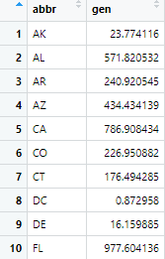
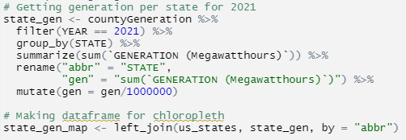

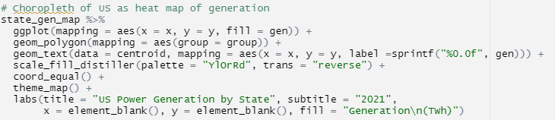
Power Hungry States

Slide 6
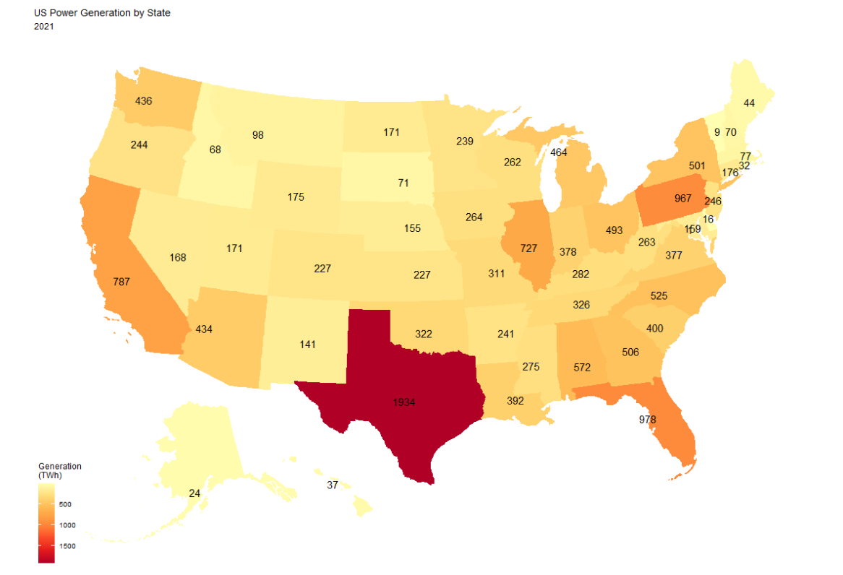
U.S. Choropleth: Generation by State (2021)

Slide 7
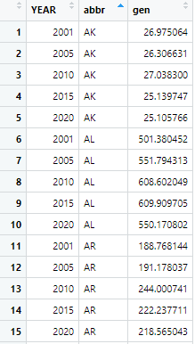
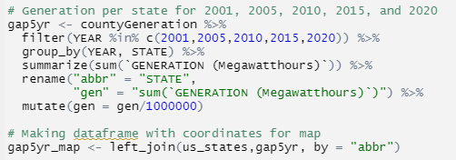
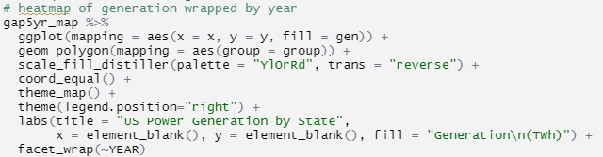
Change over Time?

Slide 8
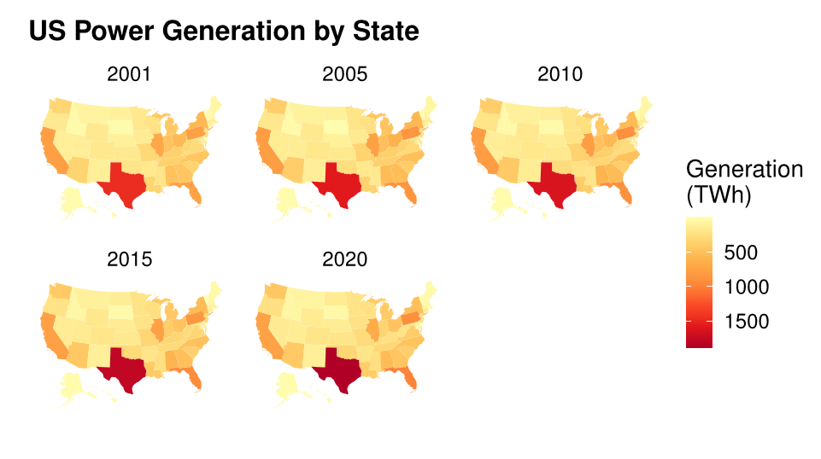
U.S. Choropleth: Generation by State during 21st Century

Slide 9
What types of Energy are the most efficient in terms of emissions?
Question 2

Slide 10
Types of Emissions Recorded
Datasets include Carbon Dioxide (CO₂), Sulfur Dioxide (SO₂), and Nitrogen Oxides (NO_{X} includes NO and NO₂)
Over 8 million people died in 2018 from fossil fuel pollution
NO_{X} is the most dangerous, followed by Sulfur Dioxide and Carbon Dioxide

Slide 11
Framing the Data
Average American household uses about 10 MWh of power per year
Driving a car for one year generates about 4.5 Metric Tons of CO₂
SO₂ mainly comes from burning of fossil fuels and isn’t produced often by consumers
Driving a large 18-wheeler for one mile generates about 7.0g of NO_{X}
Driving a normal car for one mile generates about .07g of NO_{X}

Slide 12
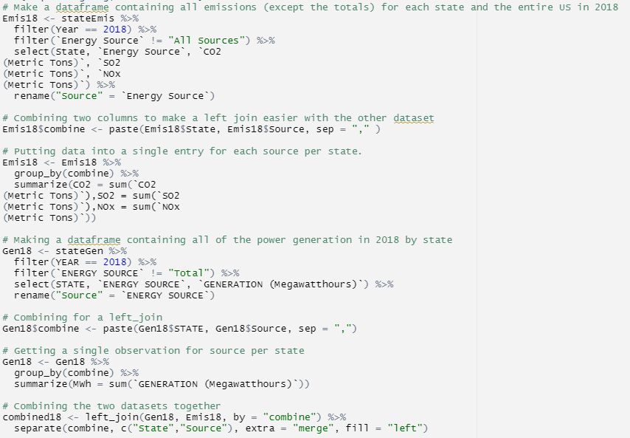
Combining Generation and Emissions

Slide 13
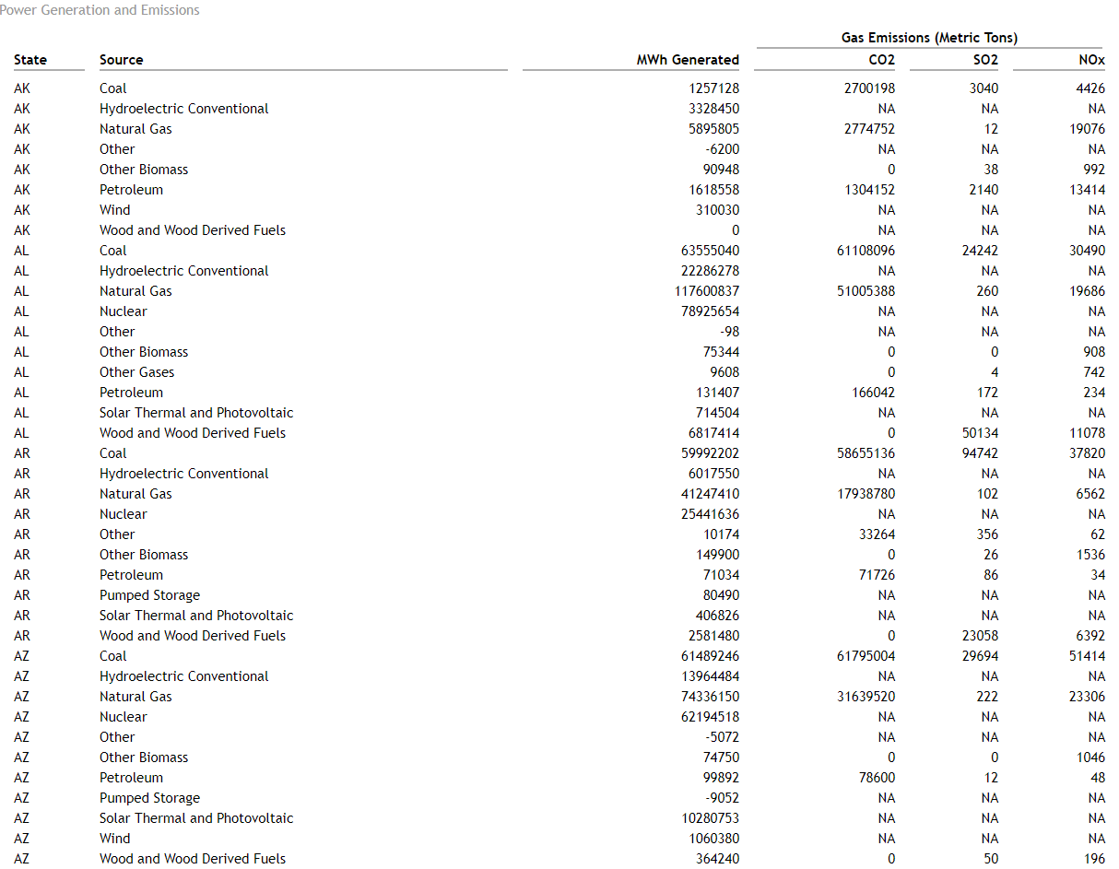
Table 1: State Power Generation and Emissions

Slide 14
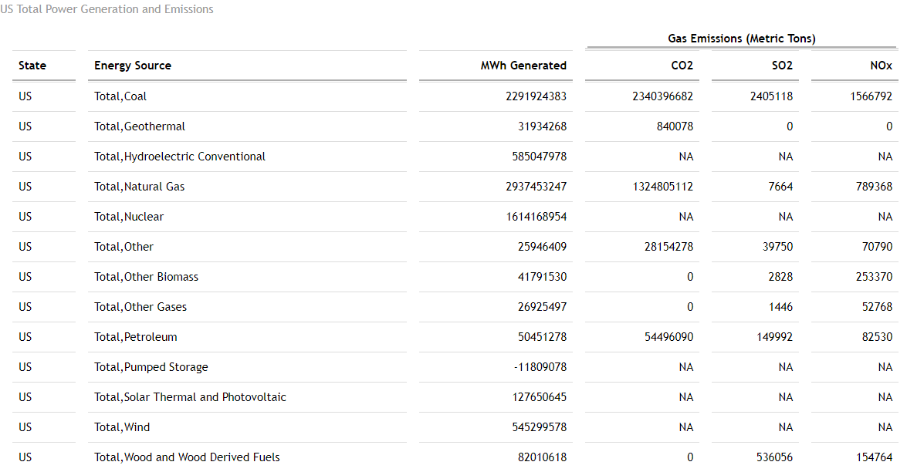
Table 2: U.S. Power Generation and Emissions

Slide 15
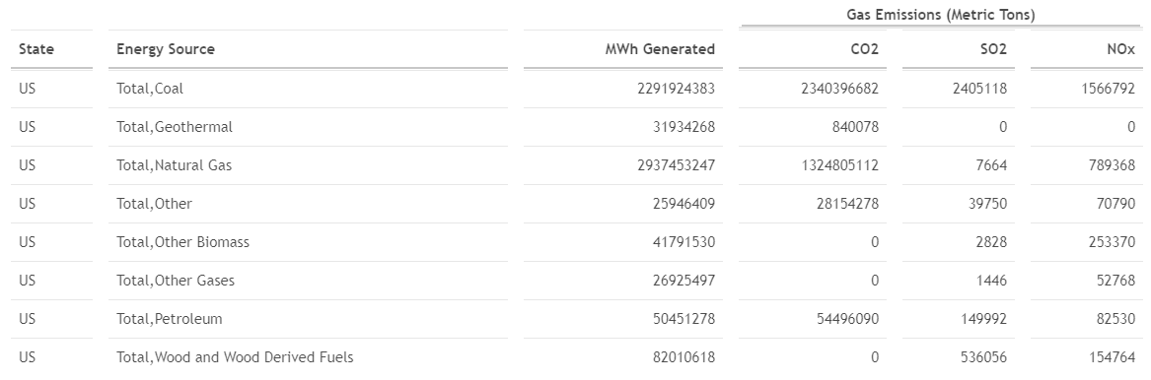
Table 3: Filtered U.S. Generation and Emissions

Slide 16
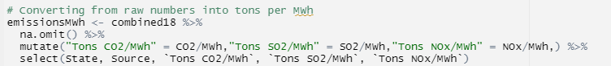
Finding the most efficient sources
Not all sources appear on each table due to not having that type of emissions
Looking to find most efficient source that makes emissions

Slide 17
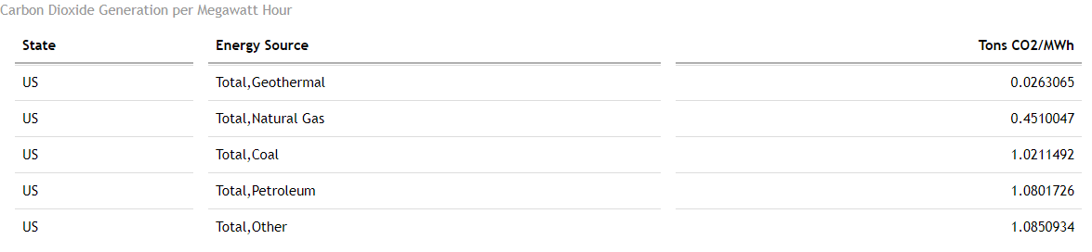
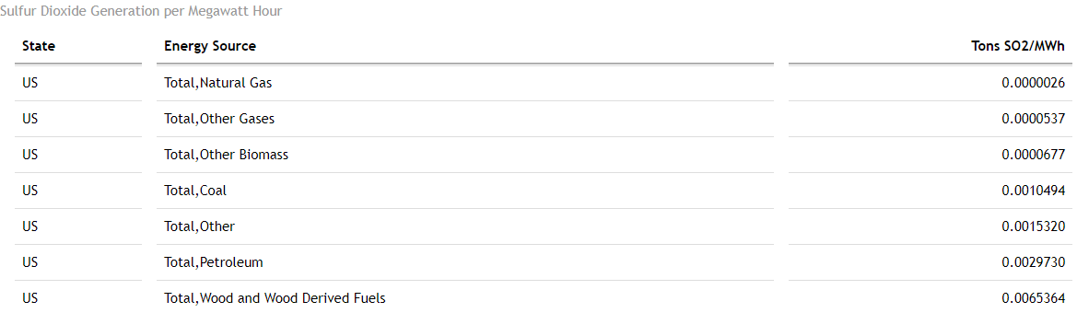
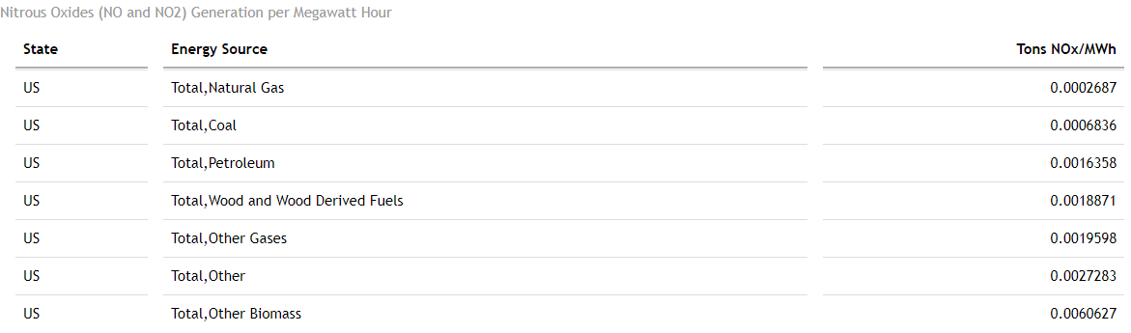
Tables 4-6: Fuel Efficiency

Slide 18
How has Clean Energy usage changed in the U.S. since 2001?
Question 3

Slide 19
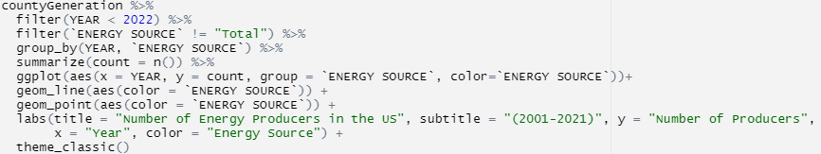
Total U.S. Energy
Scatterplot to see totals for U.S. Power Generation since 2001
Includes all sources of energy, including green energy and brown energy

Slide 20
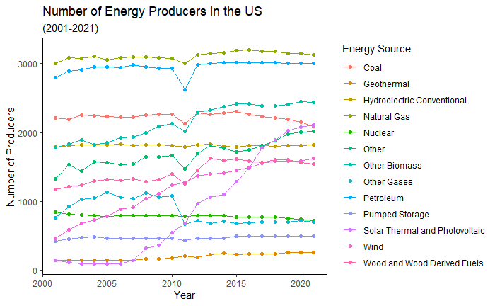
Scatterplot: Total U.S. Production

Slide 21
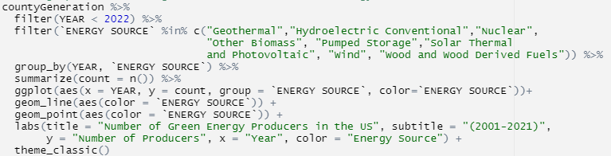
Separating Energy Types
Clean Energy refers to renewables and non-renewables with very few emissions
Filter to only clean energy sources

Slide 22
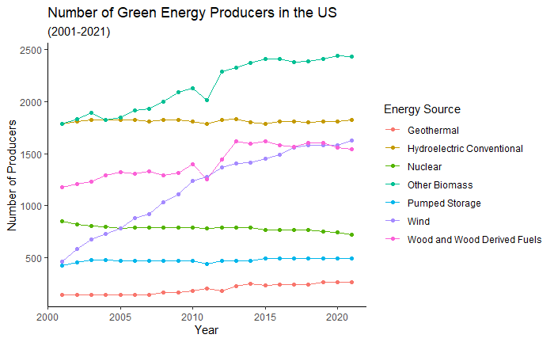
Scatterplot: U.S. Production of Green Energy

Slide 23
Part 2: Emissions for Supplying Power to California
Brannan Kovachev

Slide 24
Datasets
Site Emissions – National Emissions Inventory
Demographic & Population Statistics - America Community Survey
Annual Population Change - Annual Resident Population Estimates
County Name to FIPS
Choropleth Map Data

Slide 25
What is the distribution of emissions due to the supply of electric power across California counties?
Question 1

Slide 26
Emissions by Whom?
More than just Power Plants
NAICS Code (North American Industry Classification System)
Each code is built using sets of digits where more digits are added when more specificity is required. This allows us to be as general or specific as we like in terms of which industry we target.

Slide 27
Emissions by Whom?
NAICS Code Examples:
22 – Utilities
2211 – Electric Power Generation, Transmission, and Distribution
221113 – Nuclear Electric Power Generation

Slide 28
Emissions by Whom?
2211 – Electric Power Generation, Transmission, and Distribution

Slide 29
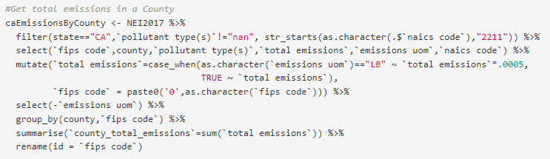
Data Wrangling

Slide 30
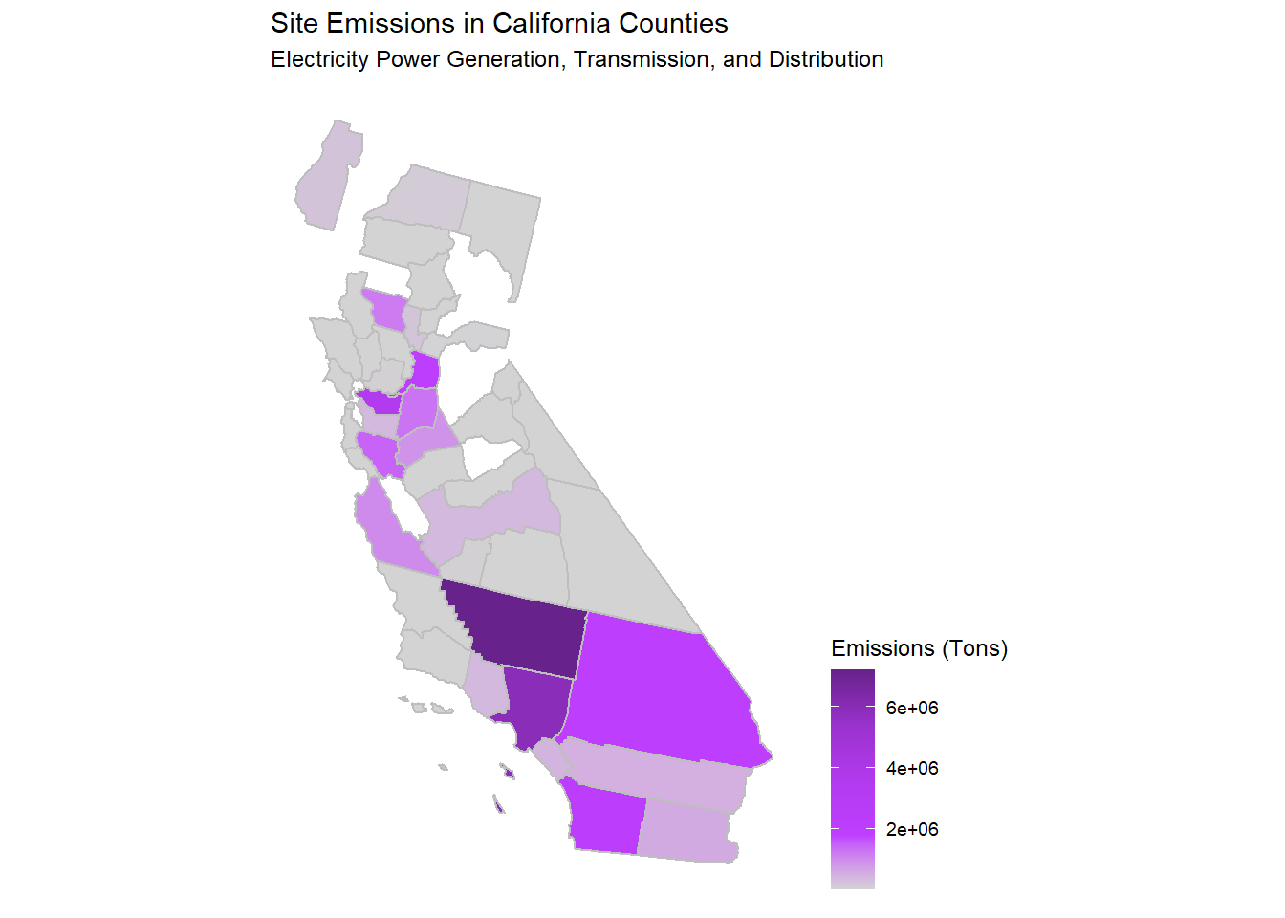
State Choropleth – Site Emissions

Slide 31
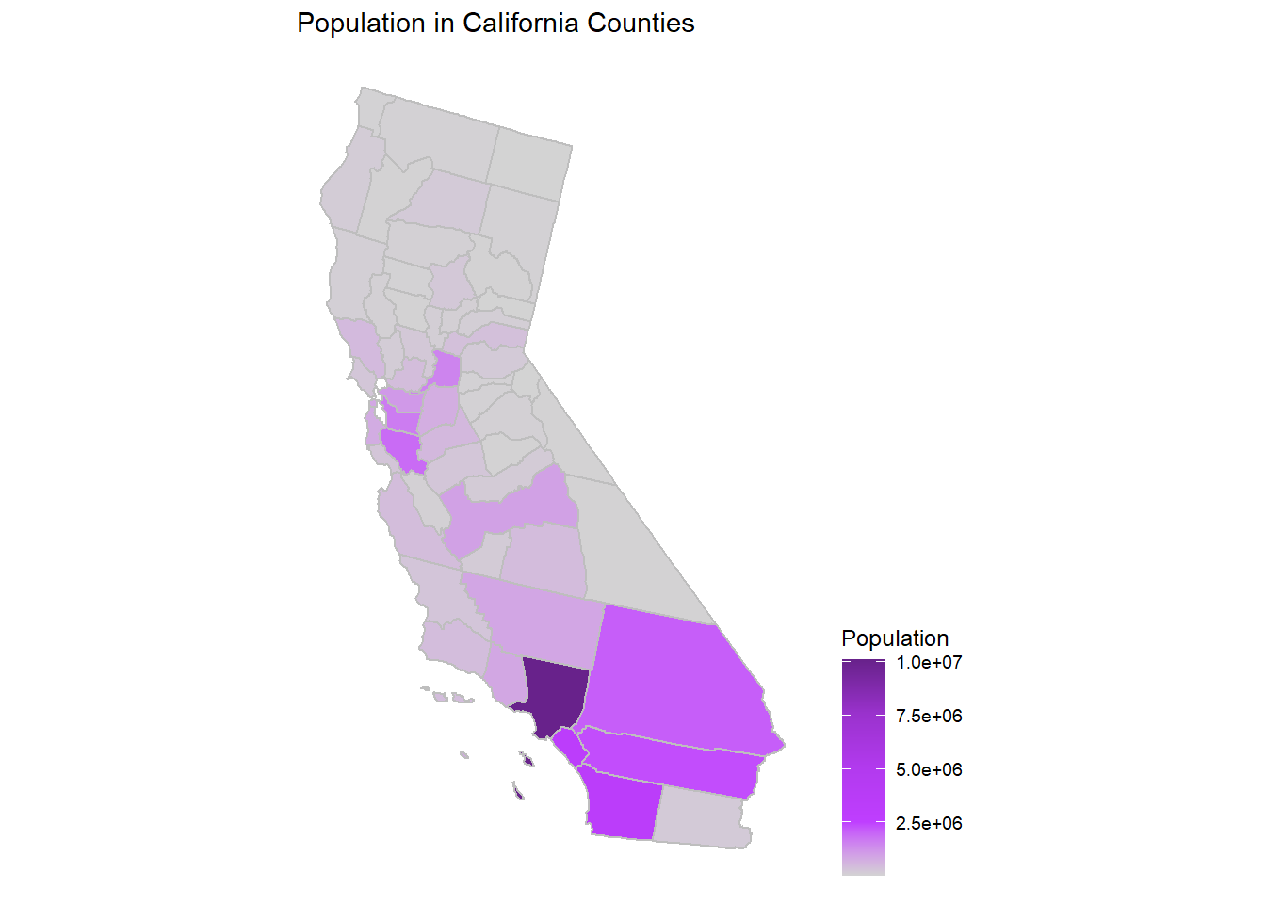
State Choropleth – Population

Slide 33
Emissions by Whom?
A few bad offenders or many sites?

Slide 34
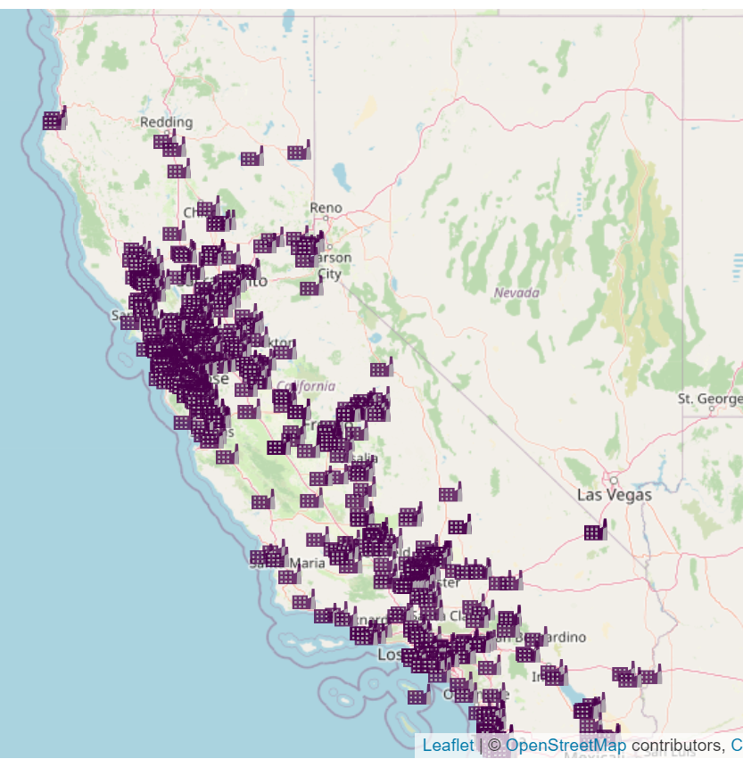
Leaflet– Site Locations

Slide 35
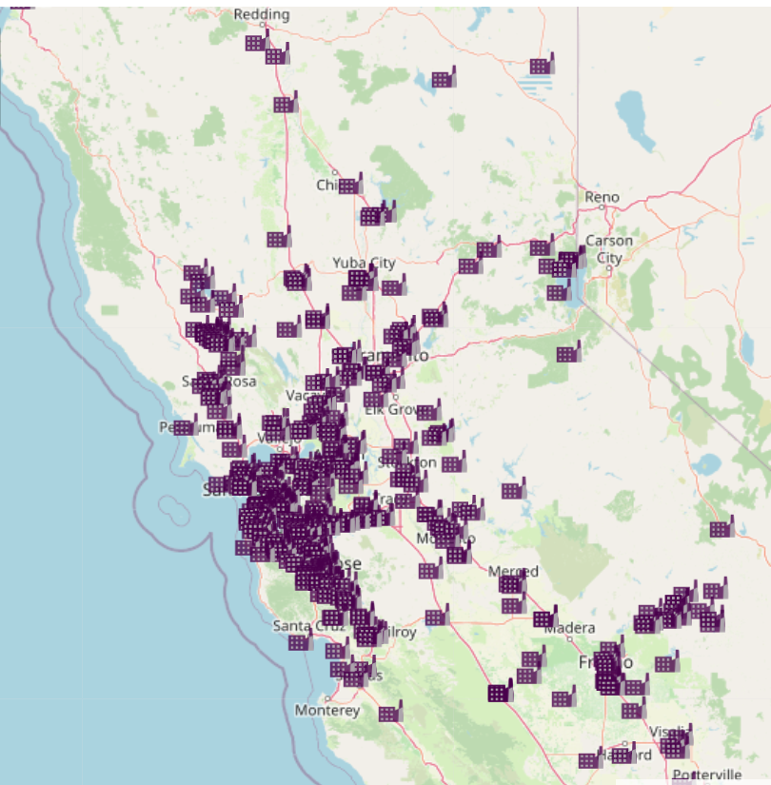
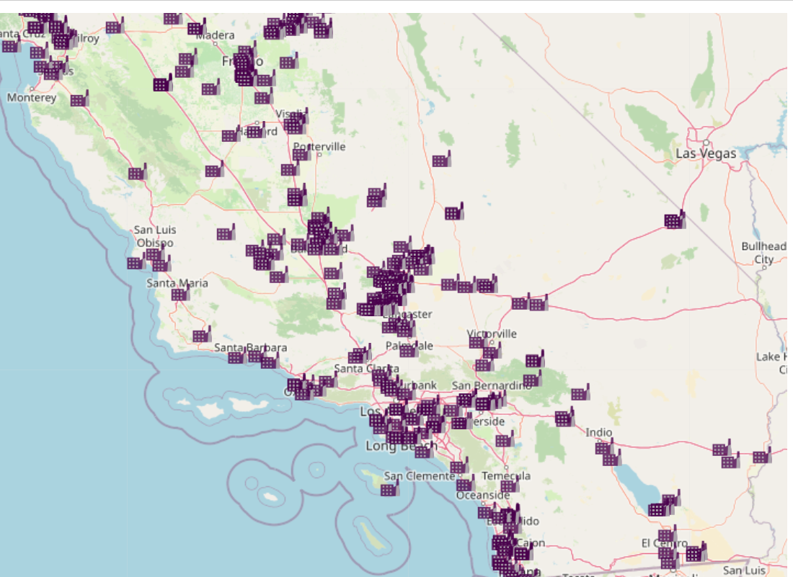

Slide 36
What is the trend between population change and a county's emissions?
Question 2

Slide 37
Not Just Population Change
I was interested in determining whether counties with large amounts of emissions had a relatively faster decreasing population.
My hypothesis was that counties with more emissions would have a population increasing more slowly or entirely decreasing when compared to those with less emissions.

Slide 38
How to Compare?
Rank the Counties
Population Change Rank
Lower Rank (#1) = More Negative Population Change
Higher Rank (#44) = More Positive Population Change
Emissions Rank
Lower Rank (#1) = Fewer Emissions
Higher Rank (#44) = More Emissions

Slide 39
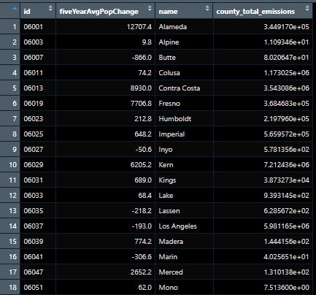
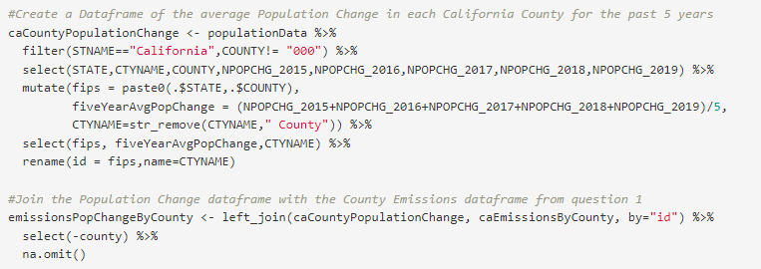
Data Wrangling

Slide 40
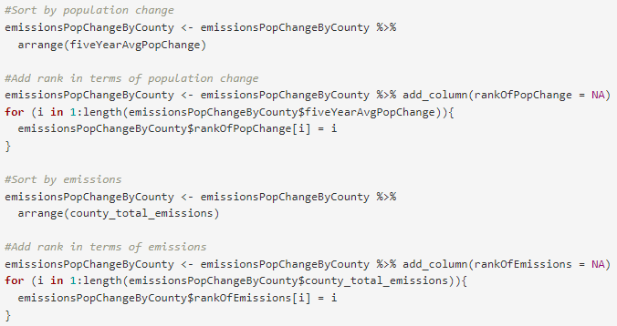
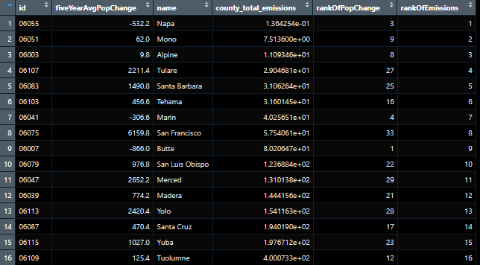
Data Wrangling

Slide 41
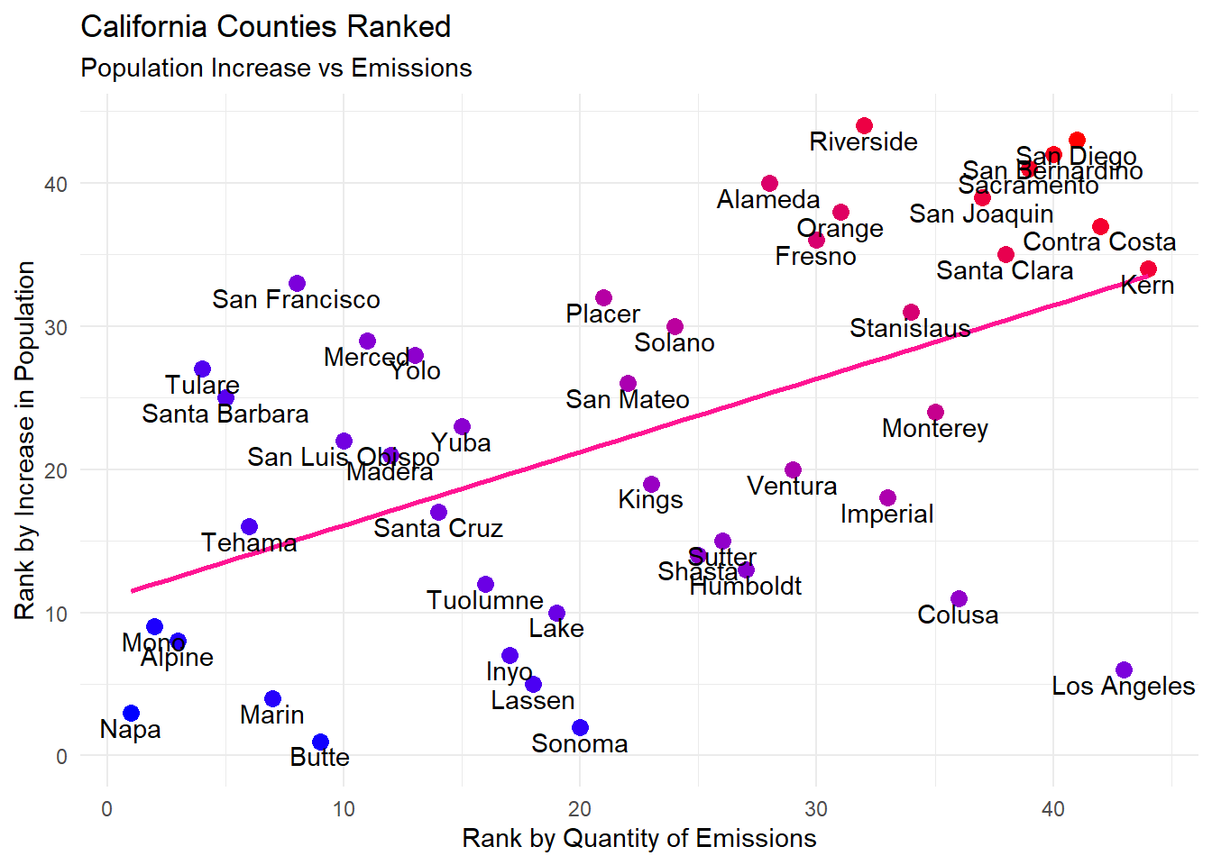
Scatterplot – Rank Comparison

Slide 42
What are the demographics in the counties with the most emissions?
Question 3

Slide 43
Whom do the Emissions Affect?
Top 10 Counties with the Most Emissions
Average Percentage of each Demographic across the State
Difference between State Average Representation and that Demographic’s Representation within the top 10 Counties

Slide 44
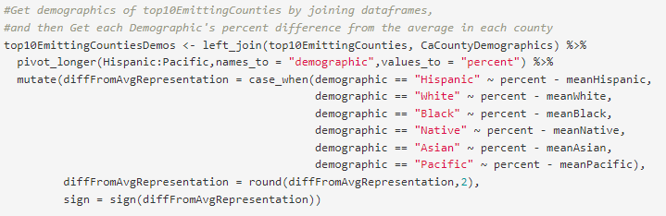
Data Wrangling

Slide 45
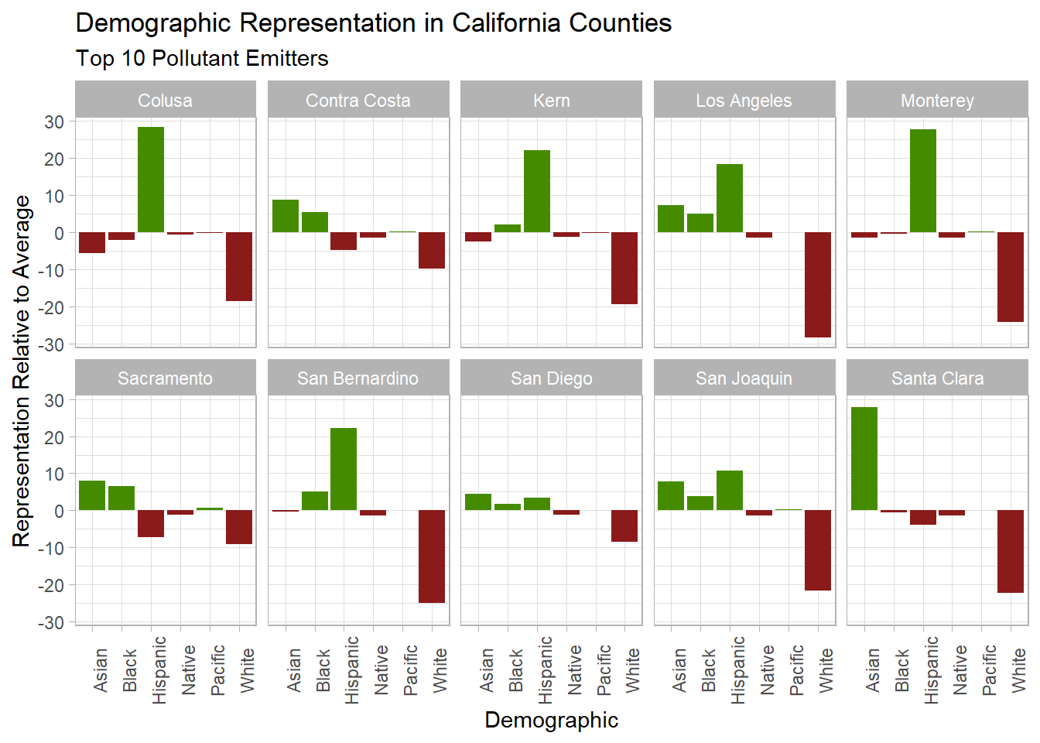
Faceted Column Chart – Demographics in Counties with the Most Emissions

Slide 46
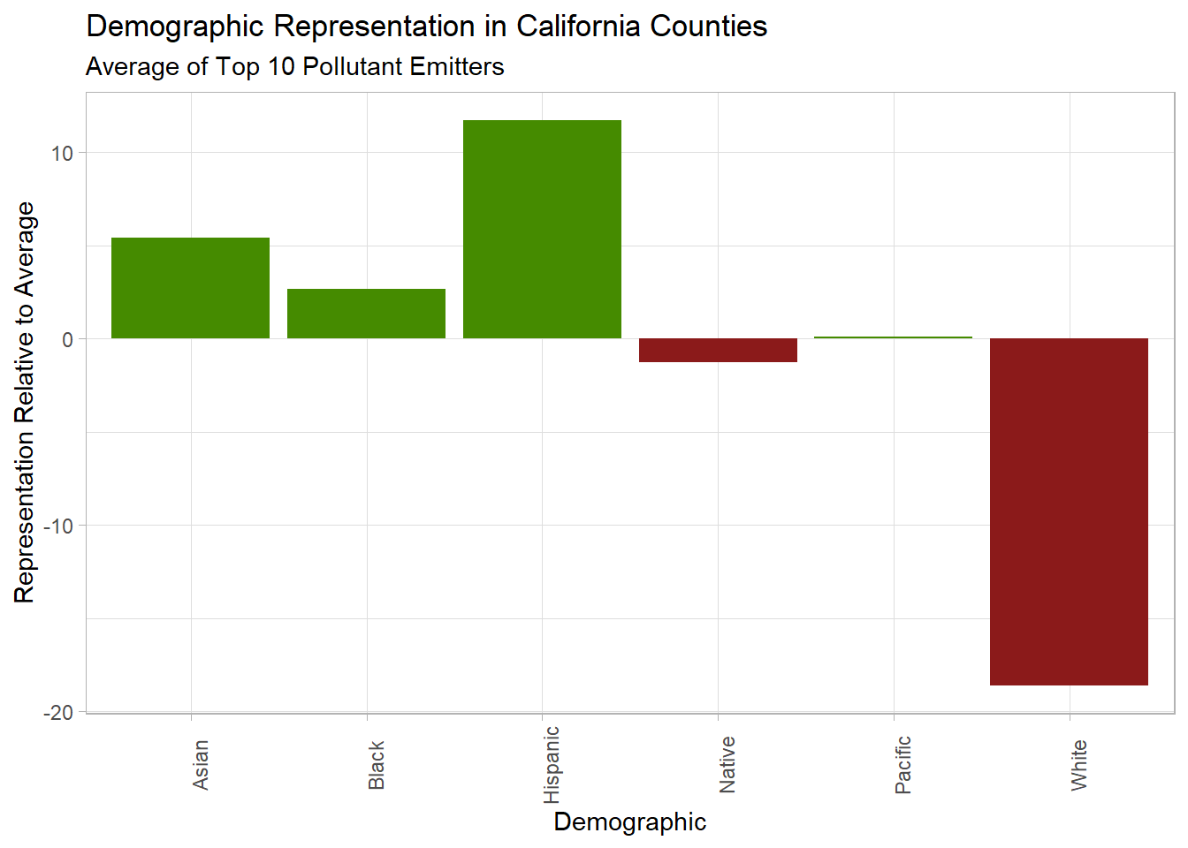
Faceted Column Chart – Demographics in Counties with the Most Emissions Average

Slide 47
What about the fewest Emissions?
Bottom 10 Counties Sorted by Emissions

Slide 48
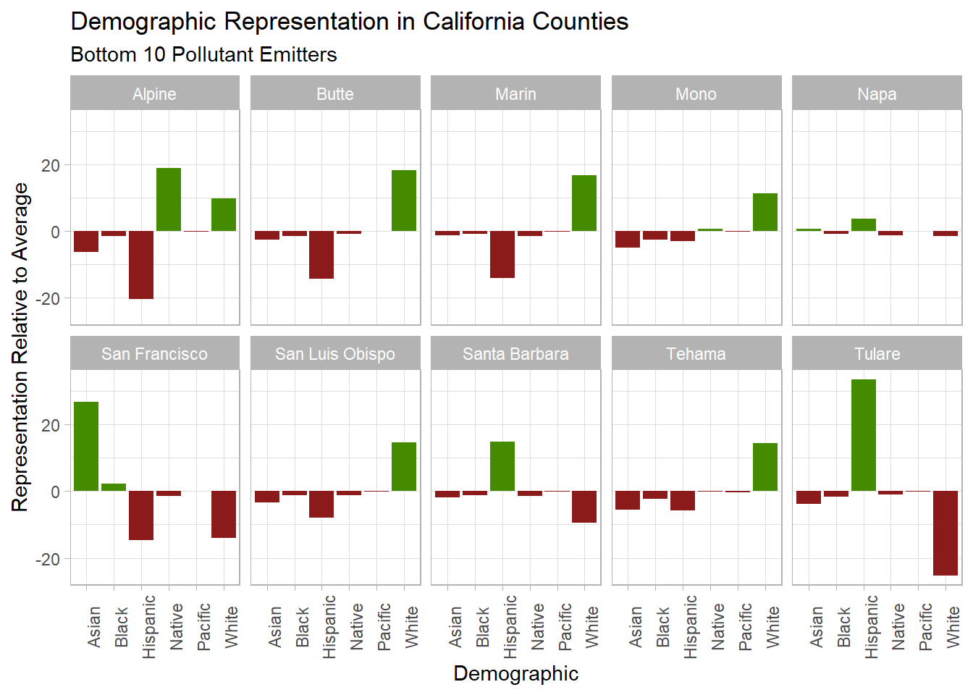
Faceted Column Chart – Demographics in Counties with the Least Emissions*

Slide 49
What about the fewest Emissions?
No Emissions

Slide 50
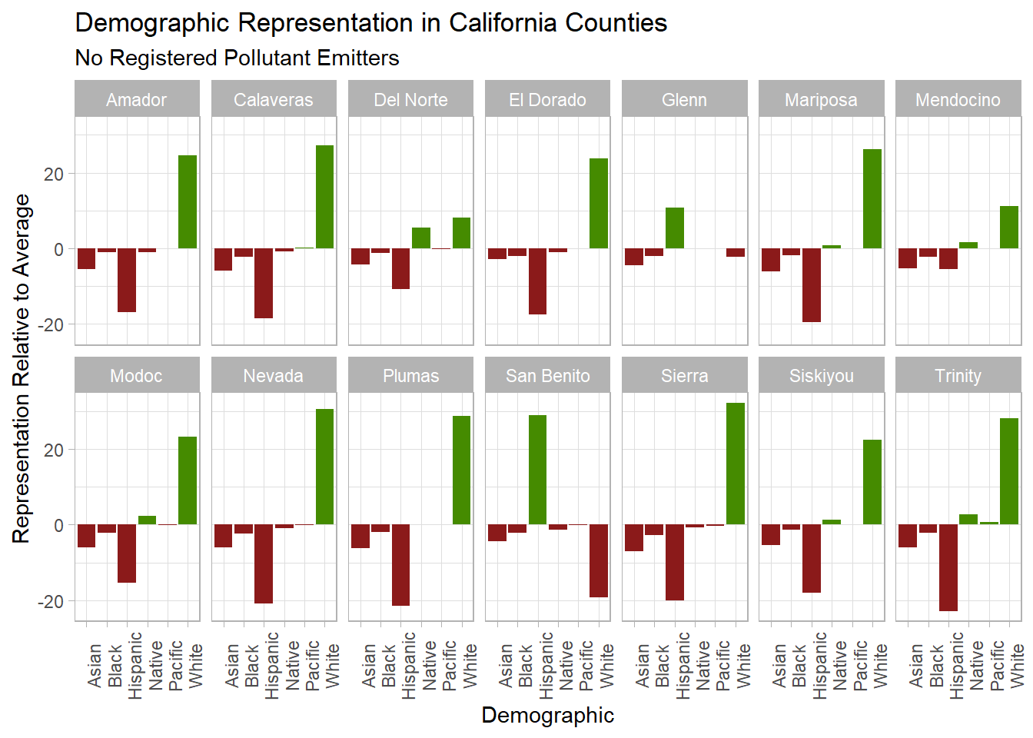
Faceted Column Chart – Demographics in Counties with No Emissions

Slide 51
Raw Percent Representation
Getting a Sense of the Magnitude

Slide 52
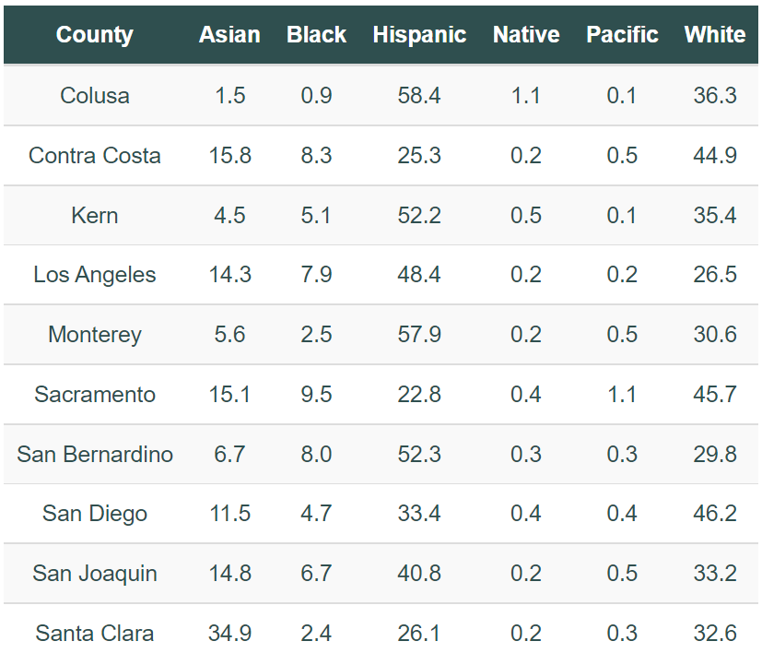
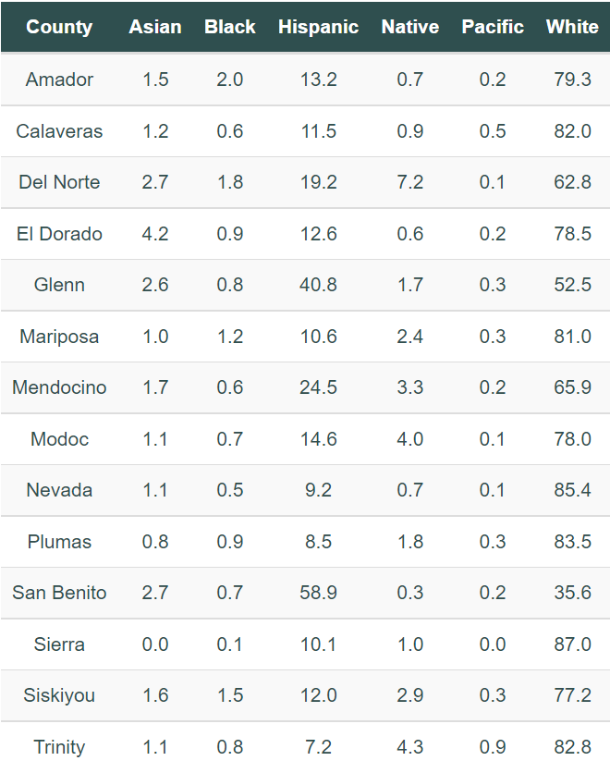
Percent Representation in the 10 Counties with the Most Emissions
Percent Representation in the Counties with No Emissions

Slide 53
Part 3: Generation and Usage
Jeremy Wright

Slide 54
Datasets
World Resources Institute Powerplants Database
CA County Power Consumption Data
ACS 2019 Selected Economic Characteristics
US Census Bureau Population Data
ggplot’s State and County Mapping Data
map’s County FIPS Codes
US Census Bureau County Shape File

Slide 55
What counties in CA generate the most power, and which ones consume the most power?
Question 1

Slide 56
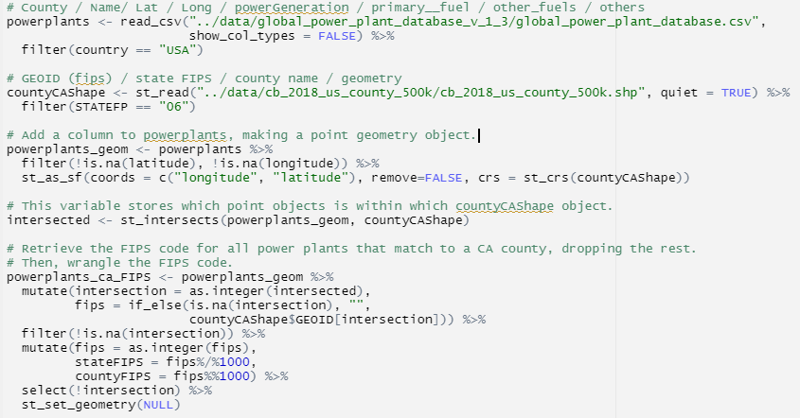
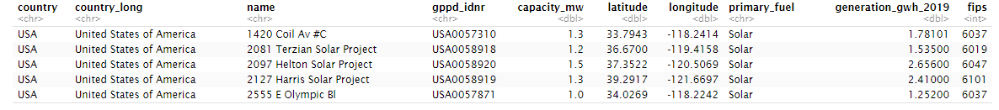
Matching Powerplants to Counties

Slide 57
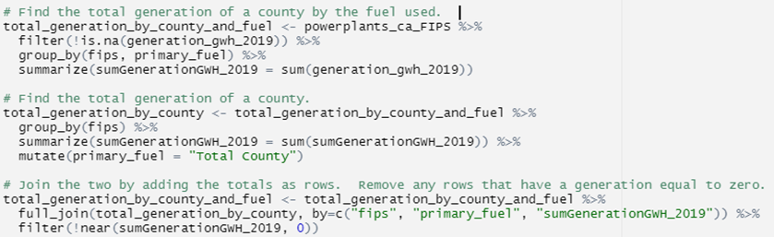
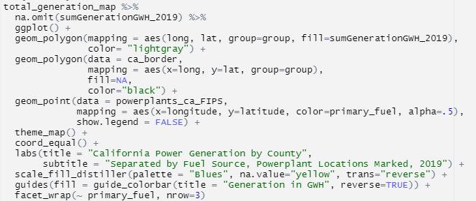
Summing and Mapping

Slide 58
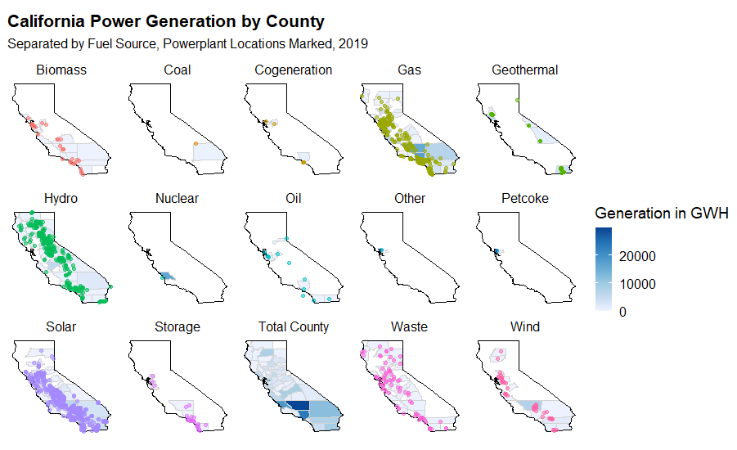

Slide 59
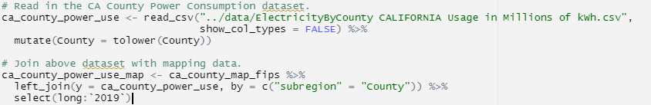
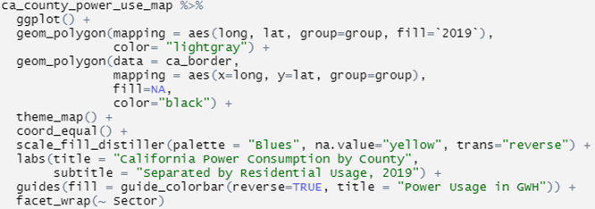
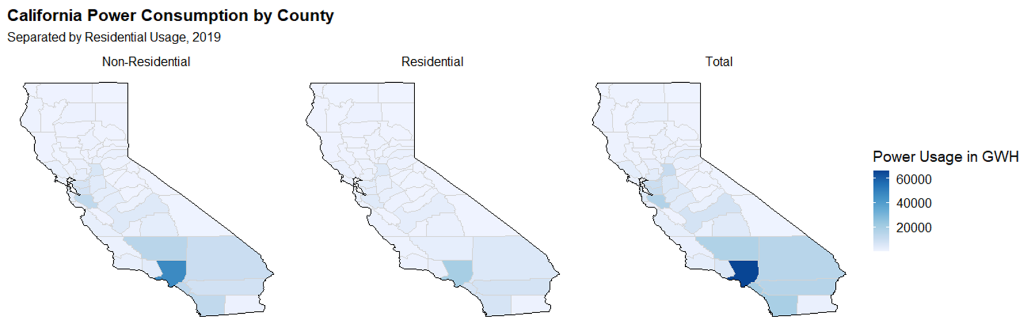
Power Usage

Slide 60
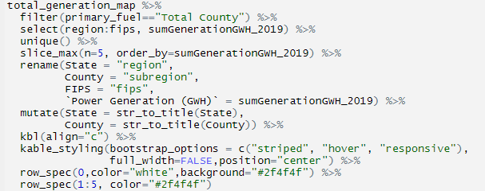
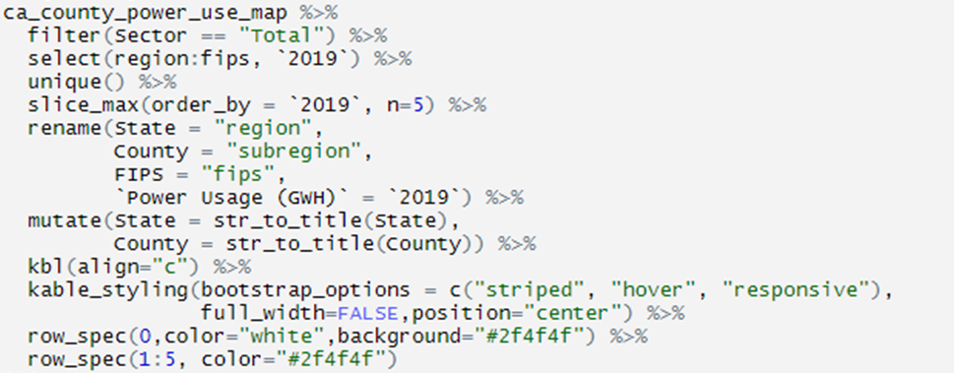
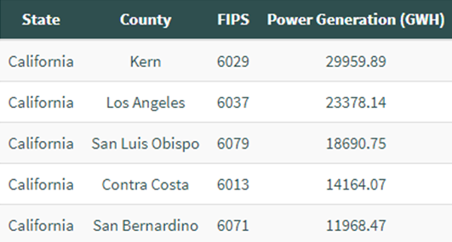
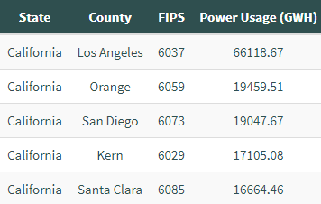
5 Counties with Highest Generation
5 Counties with Highest Usage

Slide 61
In California, what counties have an energy surplus and which counties have an energy deficit?
Question 2

Slide 62

Wrangling

Slide 63





Slide 64


5 Counties with Highest Net Energy
5 Counties with Lowest Net Energy

Slide 65


5 Counties with Highest Net Energy to Use Ratio
5 Counties with Lowest Net Energy to Use Ratio

Slide 66
How is median income related to energy production and consumption?
Question 3

Slide 67

Wrangling

Slide 68


Wrangling Continued

Slide 69


Slide 70
Questions?

